Slide 1
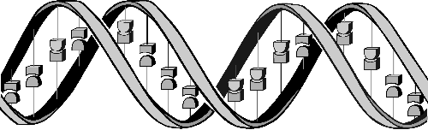
Artificial Intelligence
Lec05
Evolutionary Computation: Genetic algorithms

Slide 2
Evolutionary Computation: Genetic algorithms
Natural evolution
Simulation of natural evolution: Basic Genetic algorithms
Case study
  Case of one integer variable
  Case of two real variables

Slide 3
About Machine Learning
Machine learning involves adaptive mechanisms that enable computers to learn from experience, learn by example and learn by analogy.
Learning capabilities can improve the performance of an intelligent system over time.
The most popular approaches to machine learning are genetic algorithms and artificial neural networks.

Slide 4
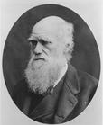
natural evolution
On 1 July 1858, Charles Darwin presented his theory of evolution before the Linnean Society of London. This day marks the beginning of a revolution in biology.
Darwin’s classical theory of evolution, together with Weismann’s theory of natural selection and Mendel’s concept of genetics, now represent the neo-Darwinian paradigm.

Slide 5
Neo-Darwinism is based on processes of reproduction, mutation, competition and selection.
  The power to reproduce appears to be an essential property of life.
  The power to mutate is also guaranteed in any living organism that reproduces itself in a continuously changing environment.
  Processes of competition and selection normally take place in the natural world, where expanding populations of different species are limited by a finite space.

Slide 6
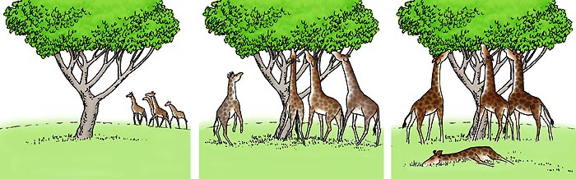
Intelligence can be defined as the capability of a system to adapt its behaviour to ever-changing environment. (Turing, 1950)
Evolution can be seen as a process leading to the maintenance of a population’s ability to survive and reproduce in a specific environment. This ability is called evolutionary fitness.
The goal of evolution is to generate a population of individuals with increasing fitness.

Slide 7
How is a population with increasing fitness generated?
Let us consider a population of rabbits. Some rabbits are faster than others, and we may say that these rabbits possess superior fitness, because they have a greater chance of avoiding foxes, surviving and then breeding.
If two parents have superior fitness, there is a good chance that a combination of their genes will produce an offspring with even higher fitness. Over time the entire population of rabbits becomes faster to meet their environmental challenges in the face of foxes.

Slide 8
Evolutionary computation
Evolutionary computation simulates evolution on a computer.
The result of such a simulation is a series of optimisation algorithms.
We call them evolutionary computation, an umbrella term that combines genetic algorithms, evolution strategies and genetic programming.

Slide 9
Simulation of natural evolution
All methods of evolutionary computation simulate natural evolution by creating a population of individuals, evaluating their fitness, generating a new population through genetic operations, and repeating this process a number of times.
We will start with Genetic Algorithms (GAs) as most of the other evolutionary algorithms can be viewed as variations of genetic algorithms.

Slide 10
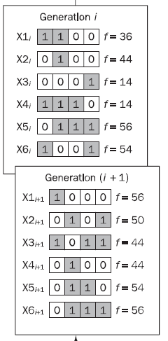
Genetic Algorithms
In the early 1970s, John Holland introduced the concept of genetic algorithms.
Holland’s GA can be represented by a sequence of procedural steps for moving from one population of artificial ‘chromosomes’ to a new population.

Slide 11
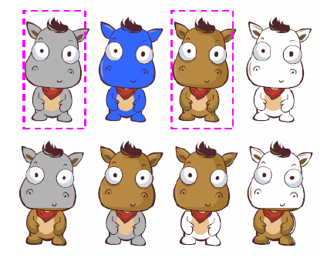
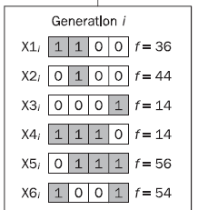
Genetic Algorithms
It uses ‘natural’ selection and genetics-inspired techniques known as crossover and mutation.
Each artificial “chromosomes” consists of a number of “genes”, and each gene is represented by 0 or 1:

Slide 12
Two mechanisms link a GA to the problem it is solving: encoding and evaluation.
An evaluation function is used to measure the chromosome’s performance, or fitness, for the problem to be solved (an evaluation function in GAs plays the same role the environment plays in natural evolution)

Slide 13
Basic genetic algorithms
Step 1: Represent the problem variable as a chromosome of a fixed length, choose the size of a chromosome population N, the crossover probability p_{c} and the mutation probability p_{m}.
Step 2: Define a fitness function to measure the performance, or fitness, of an individual chromosome in the problem domain. The fitness function establishes the basis for selecting chromosomes that will be mated during reproduction.

Slide 14
Step 3: Randomly generate an initial population of chromosomes of size N: x₁, x₂ , . . . , x_{N}
Step 4: Calculate the fitness of each individual chromosome: f (x₁), f (x₂), . . . , f (x_{N})

Slide 15
Step 5: Select a pair of chromosomes for mating from the current population. Parent chromosomes are selected with a probability related to their fitness.
Step 6: Create a pair of offspring chromosomes by applying the genetic operators  crossover and mutation.
Step 7: Place the created offspring chromosomes in the new population.
Step 8: Repeat Step 5 until the size of the new chromosome population becomes equal to the size of the initial population, N.

Slide 16
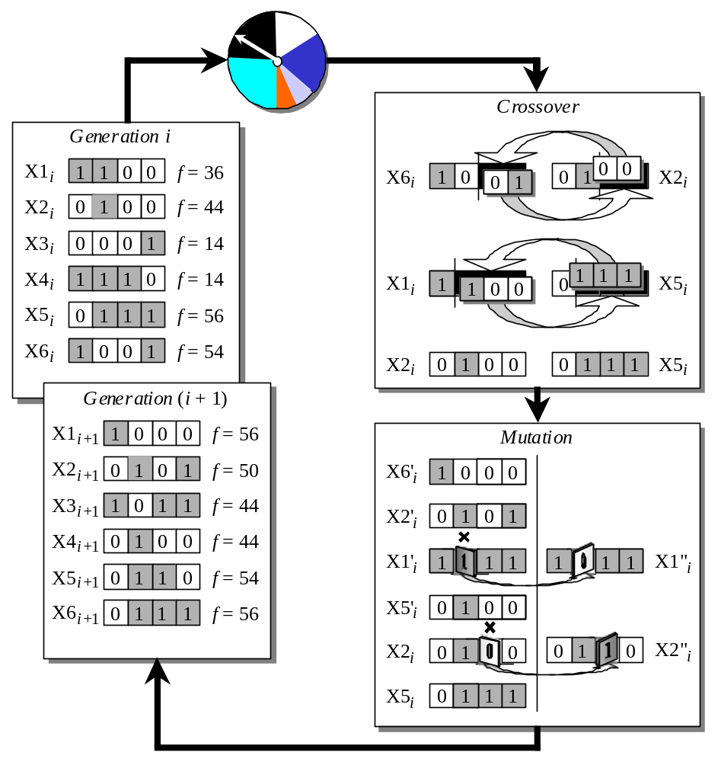
Step 9: Replace the initial (parent) chromosome population with the new (offspring) population.
Step 10: Go to Step 4, and repeat the process until the termination criterion is satisfied.

Slide 17
termination criterion
GA represents an iterative process. Each iteration is called a generation.
A common practice is to terminate a GA after a specified number of generations and then examine the best chromosomes in the population. If no satisfactory solution is found, the GA is restarted.

Slide 18
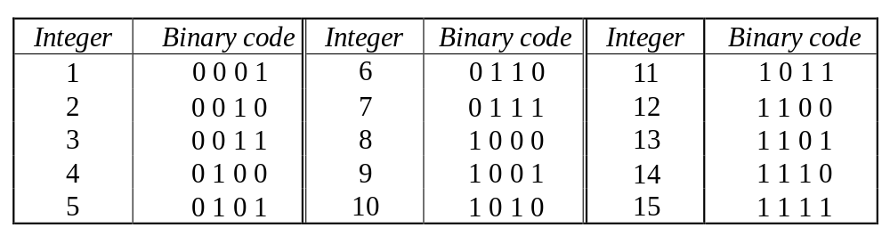
Genetic algorithms: case study
A simple example will help us to understand how a GA works. Let us find the maximum value of the function (15x  x²) where parameter x varies between 0 and 15. For simplicity, we may assume that x takes only integer values. Thus, chromosomes can be built with only four genes:

Slide 19
Suppose that the size of the chromosome population N is 6, the crossover probability p_{c} equals 0.7, and the mutation probability p_{m} equals 0.001.
The fitness function in our example is defined by
f(x) = 15 x – x²

Slide 20
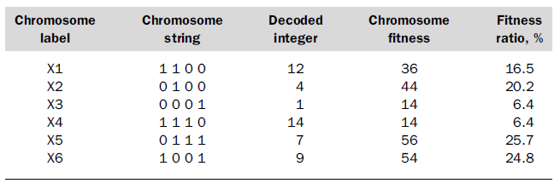
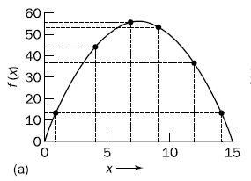
The fitness function and chromosome locations
f(x) = 15 x – x²

Slide 21
The last column in Table shows the ratio of the individual chromosome’s fitness to the population’s total fitness. This ratio determines the chromosome’s chance of being selected for mating so that the chromosome’s average fitness improves from one generation to the next.

Slide 22
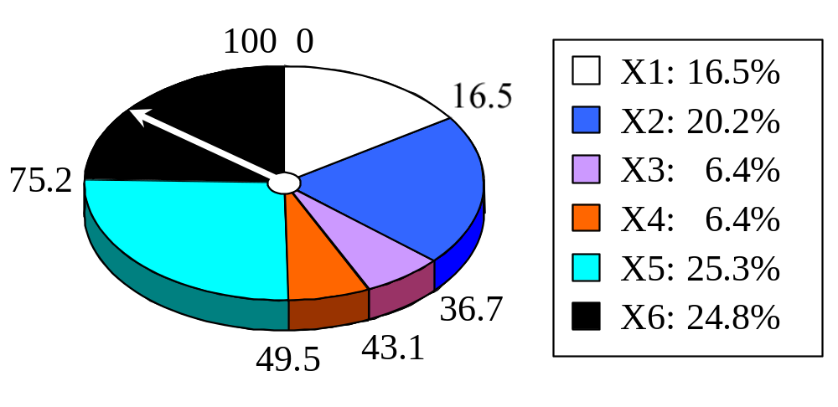
Roulette wheel selection
The most commonly used chromosome selection techniques is the roulette wheel selection.

Slide 23
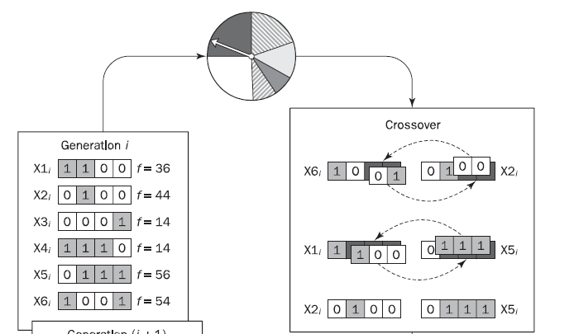
Roulette wheel selection
In our example, we have an initial population of 6 chromosomes. Thus, to establish the same population in the next generation, the roulette wheel would be spun six times.
Once a pair of parent chromosomes is selected, the crossover operator is applied.

Slide 24
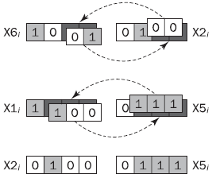
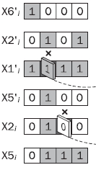
Crossover operator
First, the crossover operator randomly chooses a crossover point where two parent chromosomes “break”, and then exchanges the chromosome parts after that point. As a result, two new offspring are created.
If a pair of chromosomes does not cross over, then the chromosome cloning takes place, and the offspring are created as exact copies of each parent.

Slide 25
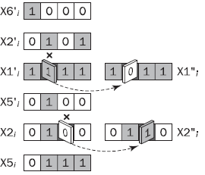
Mutation operator
Mutation represents a change in the gene.
Its role is to provide a guarantee that the search algorithm is not trapped on a local optimum.
The mutation operator flips a randomly selected gene in a chromosome.
The mutation probability is quite small in nature, and is kept low for GAs, typically in the range between 0.001 and 0.01.

Slide 26
The genetic algorithm cycle

Slide 27
Elitist GA-保留最优个体的GA
基本的遗传算法(GA)已经被证明是强不收敛。
但是保留最优个体的GA(Elitist GA)已经被证明是强收敛的。
保留最优：为了防止父代种群的最优个体在下一代发生丢失，如果父代种群的最优个体比下一代种群的最优个体更好，则把父代种群的最优个体直接复制到下一代中，将下一代种群中适应性最差的个体淘汰掉。

Slide 28
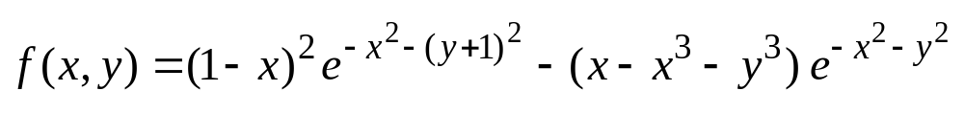
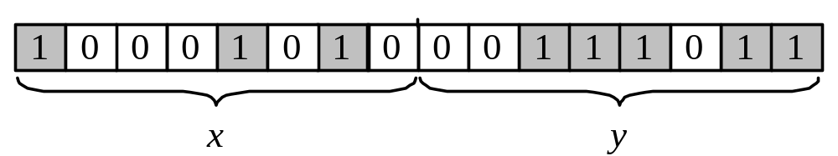
Genetic algorithms: case study
Suppose it is desired to find the maximum of the “peak” function of two variables:
where parameters x and y vary between 3 and 3.
The first step is to represent the problem variables as a chromosome  parameters x and y as a concatenated binary string:

Slide 29
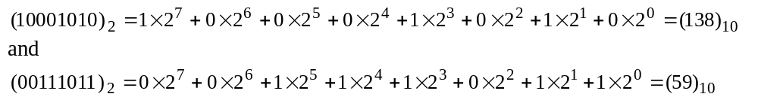
We also choose the size of the chromosome population, for instance 6, and randomly generate an initial population.
The next step is to calculate the fitness of each chromosome.
  First, a chromosome, that is a string of 16 bits, is partitioned into two 8-bit strings:
  Then these strings are converted from binary (base 2) to decimal (base 10):

Slide 30
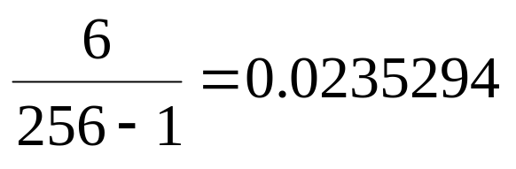
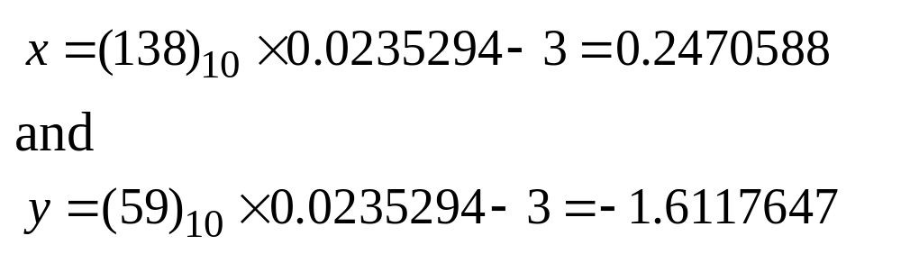
  Now the range of integers that can be handled by 8-bits, that is the range from 0 to (2⁸ - 1), is mapped to the actual range of parameters x and y, that is the range from -3 to 3:
  To obtain the actual values of x and y, we multiply their decimal values by 0.0235294 and subtract 3 from the results:
  Using decoded values of x and y as inputs in the mathematical function, the GA calculates the fitness of each chromosome.

Slide 31
To find the maximum of the “peak” function, we will use crossover with the probability equal to 0.7 and mutation with the probability equal to 0.001.
Suppose the desired number of generations is 100. That is, the GA will create 100 generations of 6 chromosomes before stopping.

Slide 32
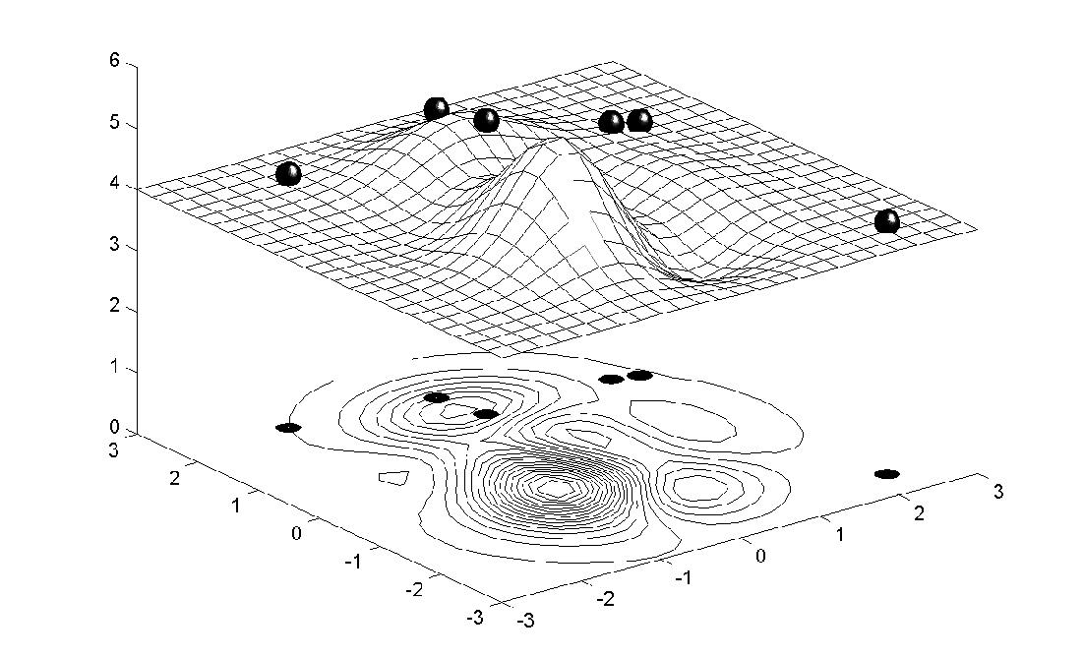
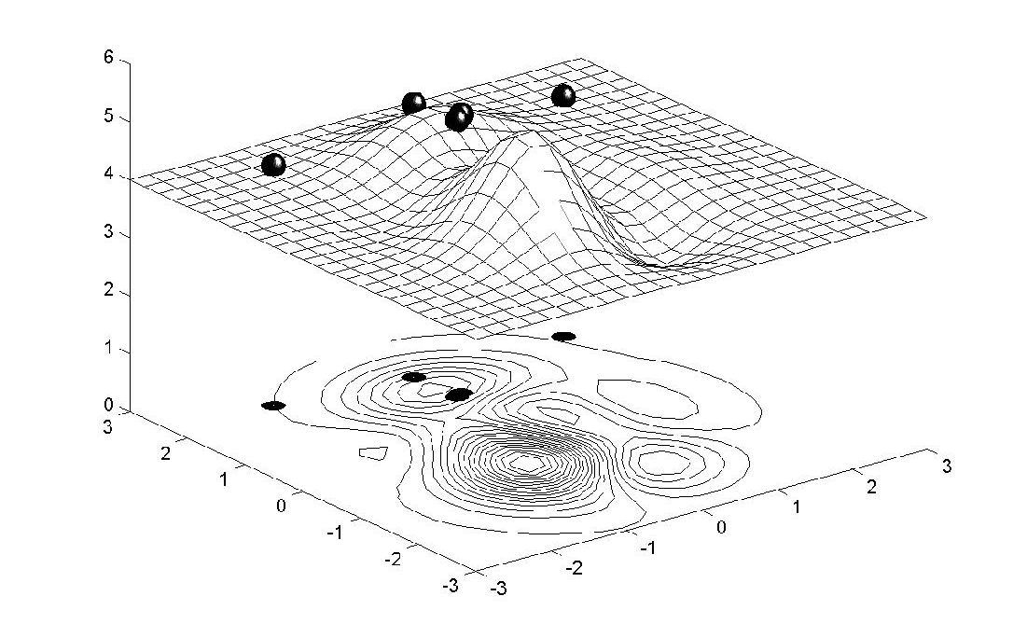
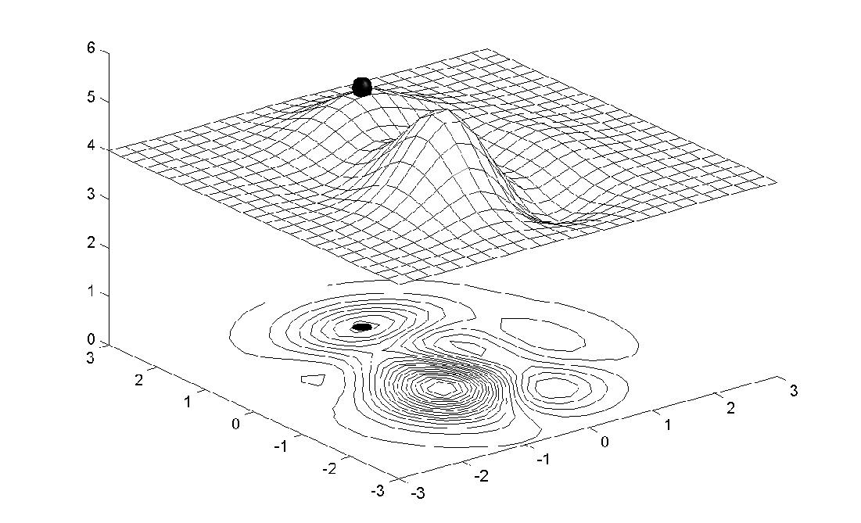
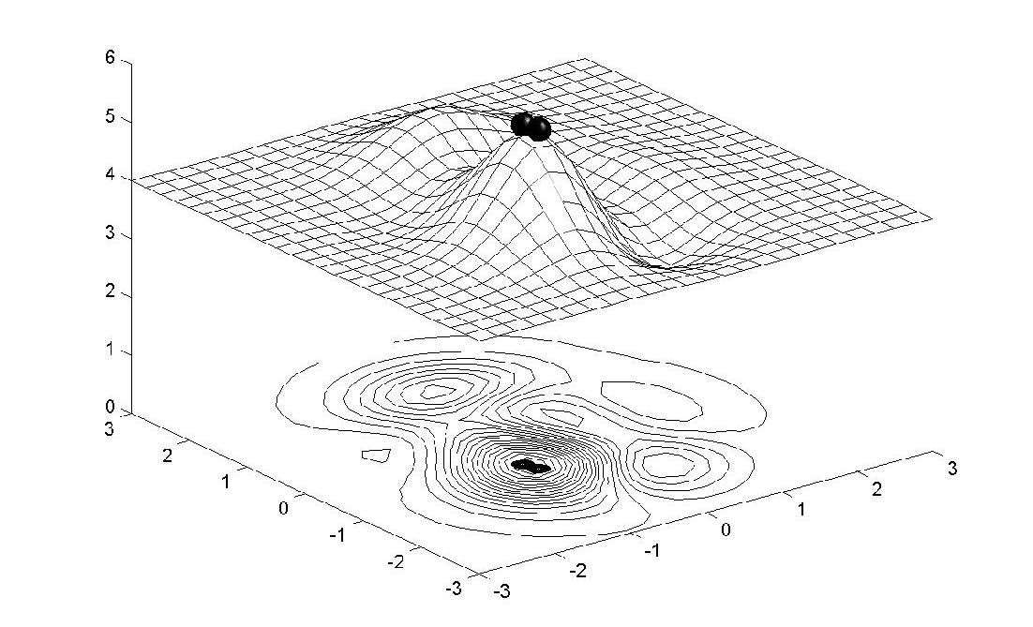
Chromosome locations on the surface
of the “peak” function: initial population
Chromosome locations on the surface
of the “peak” function: first generation
Chromosome locations on the surface
of the “peak” function: local maximum
mutation probability p_{m}=0.001
Chromosome locations on the surface
of the “peak” function: global maximum
mutation probability p_{m}=0.01

Slide 33
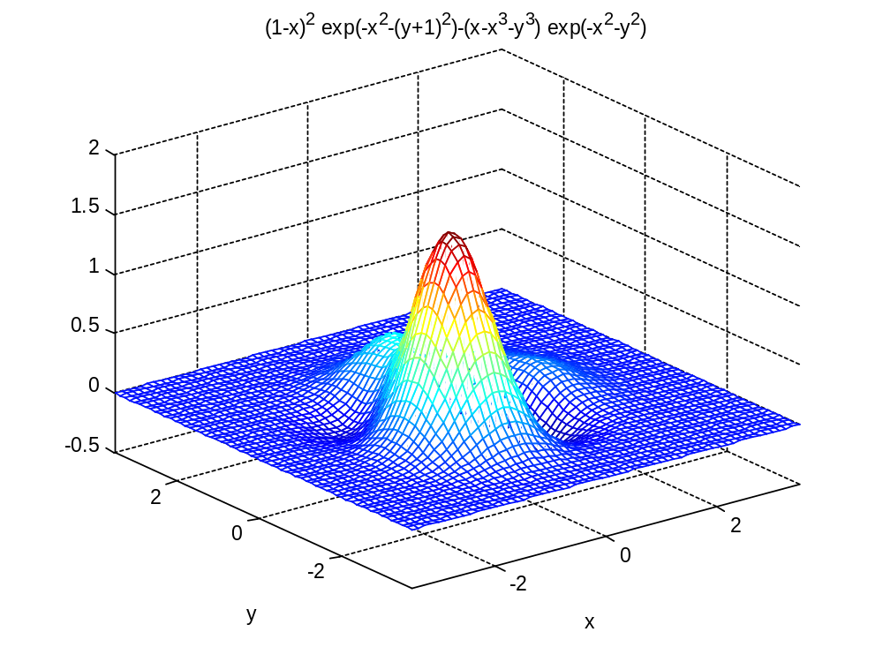

Slide 34
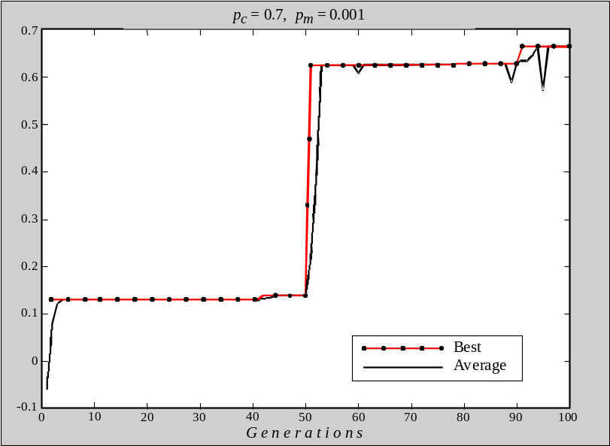
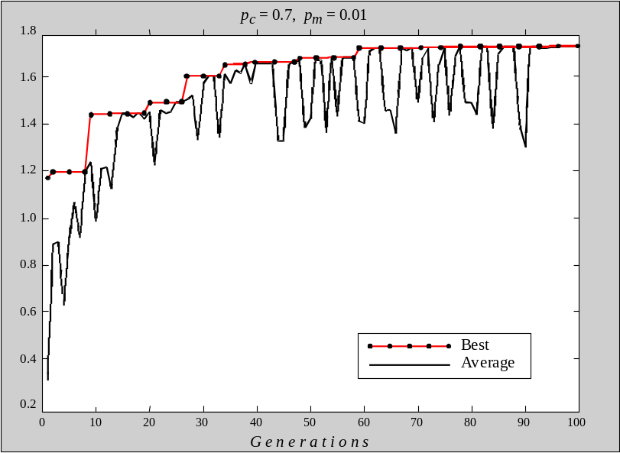
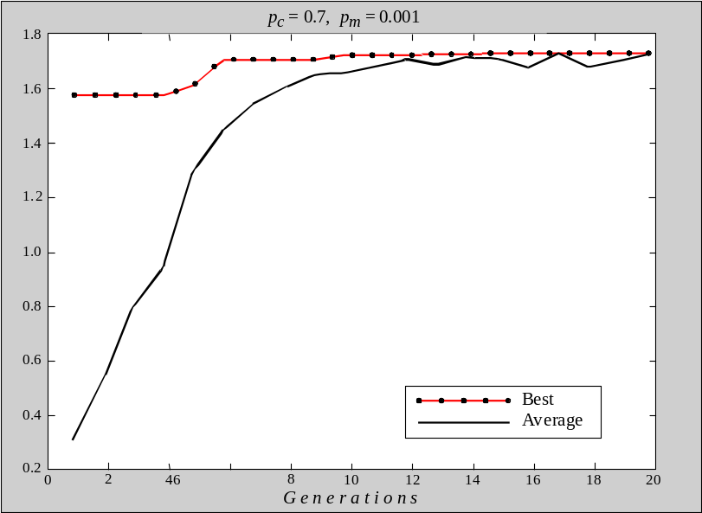
Performance graphs for 100 generations of
6 chromosomes: local maximum pm=0.001
Performance graphs for 100 generations of
6 chromosomes: global maximum pm=0.01
F i t n e s s
F i t n e s s
Performance graphs for 20 generations of
60 chromosomes
F i t n e s s

